Slide 1
Plane Graphs
CME4422 Graph Theory

Slide 2
Plane Graph
A plane graph can be drawn on a plane without any edges crossing.
A plane drawing shows a plane graph without any edges crossing.
If a graph is non-planar, it cannot have any plane drawing.

Slide 3
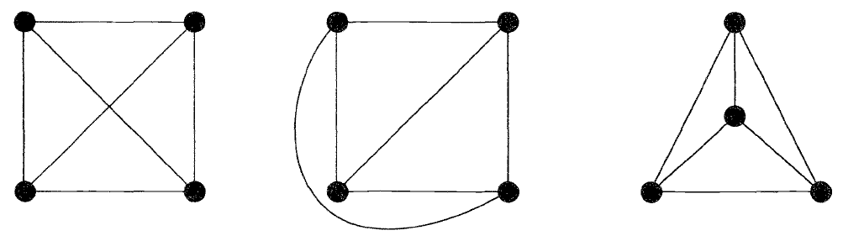
K-4 is a plane graph:
Plane drawing
Plane drawing

Slide 4
Theorem
Every planar simple graph can be drawn with straight lines, as in the 3rd drawing on the last example.
K_{3,3} and K₅ are non-planar, and are used to identify non-planar graphs.

Slide 5


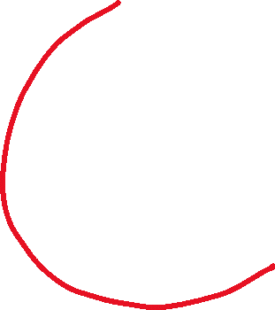
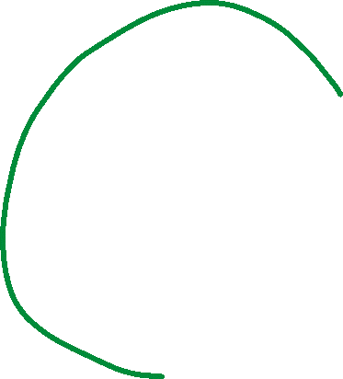
K_{3,3}

Slide 6
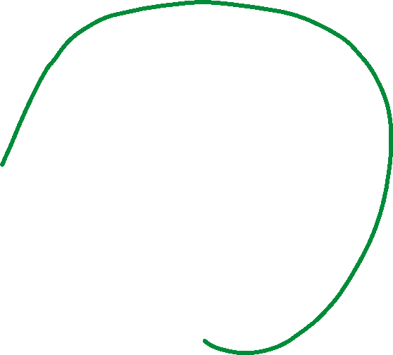
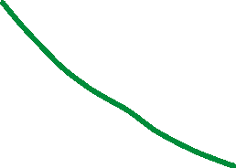
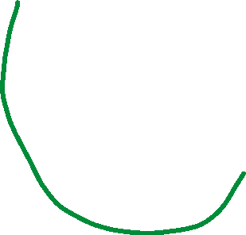



K₅

Slide 7
Every subgraph of a planar graph is planar.
Every graph that has a non-planar subgraph is itself non-planar.
So every non-planar graph has either K_{3,3} or K₅ as a subgraph.

Slide 8
Homeomorphic Graphs
Two graphs G and H are homeomorphic if they can be converted to a common graph G’=H’ by inserting new vertices of
degree 2.

Slide 9
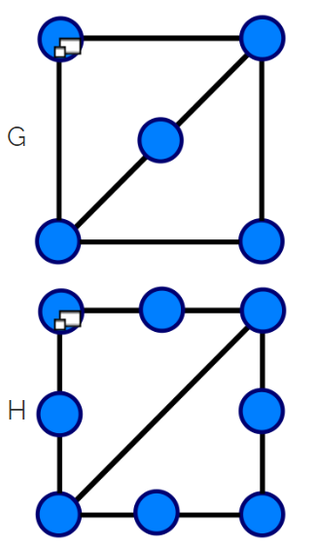
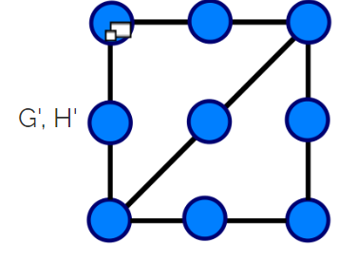
Homeomorphic Graphs

Slide 10
Kuratowski’s Theorem
A graph is planar if it has no sub-graph homeomorphic to K_{3,3} or K₅.

Slide 11
Crossing Number
For a non-planar graph, the crossing number is the minimum number of times edges must cross to be drawn on a plane.
For example, both K_{3,3} and K₅ have a crossing number of 1.
A planar graph has cr(G)=0.
It’s a measure of how unplanar the graph is.
Crossing is defined for only two edges.

Slide 12
Example:
Show that W5 is a planar graph by drawing.

Slide 13
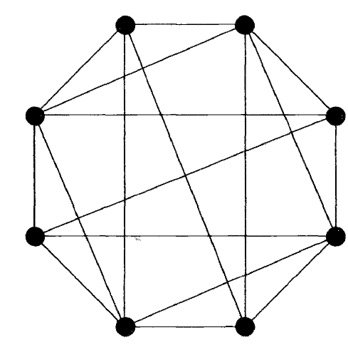
Example:
Show that the graph below is planar by drawing.

Slide 14
Faces
If G is a planar graph, any plane drawing of G divides the plane outside of G into regions called faces.
An unbounded face is called an infinite face.

Slide 15

Example:
c
d
b
j
a
h
g
i
f
e
k

Slide 16
Example
We can rearrange the vertices so that any face can be chosen as the infinite face:
d
j
i
c
b
k
h
g
e
a
f

Slide 17
Euler’s Formula(1750)
If G is a plane drawing of a connected planar graph then n-m+f=2 where
n: # of vertices
m: # of edges
f: # of faces
In our example: 11-13+4=2.

Slide 18
If G is disconnected, we have:
n-m+f=k+1 where k is the # of components.
Every simple planar graph has a maximum degree of 5.

Slide 19
Thickness
Thickness t(G) of a graph is the minimum # of planar graphs that should be superimposed to form G.
Like crossing number, thickness is a measure of how unplanar the graph is.
t(planar) = 1, t(K₅)=t(K_{3,3})=2.

Slide 20
Example: t(K₆)=2

Slide 21
Graphs on other Surfaces
We have seen that we can’t draw K_{3,3} and K₅ on a plane or a sphere without any crossings.
We define genus as the number of holes in a shape. So sphere has genus 0 and torus has genus 1.
A graph of genus g can be drawn on a surface of genus g, but not on g-1.

Slide 22
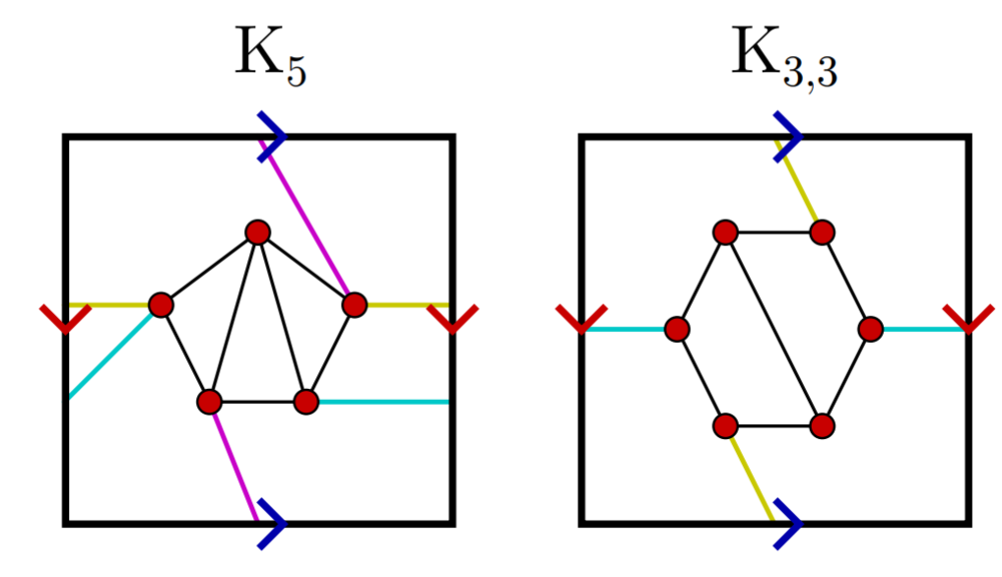
K_{3,3} and K₅ can be drawn on a torus (g=1) but not on a sphere, so they are genus 1, or toroidal graphs.

Slide 23
Theorem
Genus of a graph does not exceed its crossing number.
If G is a connected graph of genus g then
n-m+f=2-2g
Ex. K₅->5-10+12=2-2x1

Slide 24
Dual Graphs
From an original planar graph G we can construct its dual G*:
Define a vertex v* in each face of G
Connect v* by crossing edges of G at exactly one point.

Slide 25
Example

Slide 26
If G is a planar connected graph, then G* has f=n* vertices, m=m* edges and n=f* faces.
In the example there are 5 vertices of G so 5 faces of G*, and 3 vertices of G* so 3 faces of G.

Slide 27
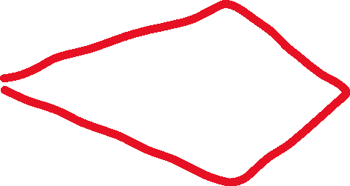
Abstract Dual
G* is called an abstract dual of G if there ‘s a one-to-one correspondence between the edges of G and G* such that any cycle in G forms a cutset in G*.

Slide 28
Theorem
A graph is planar if and only if it has an abstract dual.

Slide 29
Infinite Graphs

Slide 30
Some Definitions
If all vertices in G have finite degree, then this is a locally finite graph.

